Slide 1
Internet of Things essentials presentation LOCATION TRACKER USING GPS AND GSM MODULE
VAISHNAVI C (210701298)
VAISHARLI S (210701296)

Slide 2
AGENDA
I. ABSTRACT
II. INTRODUCTION
III. OBJECTIVE
IV. LITERATURE SURVEY
a. KEY CHALLENGES
b. MOTIVATION
V. EXISTING SYSTEM
VI. PROPOSED SYSTEM
VII.MODULES
VIII. SYSTEM ARCHITECTURE
IX. CONCLUSION AND FUTURE ENHANCEMENTS
X. REFERENCES

Slide 3
ABSTRACT
An IoT-enabled GPS location tracker system is designed for real-time monitoring. It comprises a compact device equipped with a GPS module and a push-button interface. When activated, the device retrieves its current GPS coordinates and transmits them over the Internet. Leveraging WhatsApp messaging, registered users receive instant location updates directly to their designated numbers. With a focus on efficiency and security, our system ensures reliable data transmission while maintaining user privacy. This solution offers a streamlined approach to location tracking ,suitable for various applications such as asset management and personal safety.

Slide 4
INTRODUCTION
In moments of urgency where swift action is imperative, a dependable GPS tracker can serve as a lifeline. From first responders navigating crisis situations to worried family members seeking reassurance, the demand for prompt and accurate location updates cannot be overstated. Unlike many conventional GPS trackers that entail cumbersome manual procedures, our innovative solution is engineered to streamline this process into a single step. By simplifying tracking procedures, we're introducing unprecedented ease in accessing vital location information precisely when it's needed most. Whether it entails pinpointing a lost hiker amidst rugged terrain or expediting assistance during a medical emergency within urban confines, our GPS tracker is tailored to deliver swift and pinpoint location data with unparalleled ease.

Slide 5
OBJECTIVE
Integrate Arduino, GPS Neo-6M module, and SIM800L GSM module to create a comprehensive GPS tracking system.
Develop a circuit design that enables real-time GPS location tracking and GSM communication for remote monitoring and control.
Ensure seamless integration and communication between the components to achieve accurate and reliable tracking functionality.
Provide a cost-effective and customizable solution for various applications such as vehicle tracking, asset management, and personal safety.

Slide 6
LITERATURE SURVEY
[1] IoT Based GPS Location Tracker Using Node MCU and GPS Module published in the year 2020.
A local web server displays location details, including a link to view the location directly on Google Maps.
[2] GPS Tracking System Using LoRaWan published in the year 2018.This paper focuses on integrating GPS modules in buses to track their locations and transmit data to a central server2.
[3] Real-Time Bus Tracking System published in the year 2019.This paper emphasizes on integrating GPS modules in buses for location tracking and transmitting data to a central server.

Slide 7
[4] Human Location Tracking Device using IoT published in may 2018. It leverages IoT and machine learning data models with serverless architecture based on cloud computing.
[5] ReachOut Smart Safety Device published in the year 2018.It leverages IoT and machine learning data models with serverless architecture based on cloud computing.

Slide 8
KEY CHALLENGES
Energy efficiency
Data Accuracy and Reliability
Data Privacy and Security
Network connectivity

Slide 9
MOTIVATION
Providing accurate and real-time location information.
Enhancing safety and security by tracking assets, vehicles, and individuals.
Optimizing logistics, improving efficiency, and facilitating emergency response.

Slide 10
EXISTING SYSTEM
The current system relies on manual input from users, requiring a significant amount of human effort. In emergency situations, users must manually send their location, which can be problematic and time-consuming. However, our project offers a streamlined alternative. With just one simple step – pressing a push button – our system initiates location transmission automatically. This improvement not only enhances efficiency but also ensures rapid response times during critical moments.

Slide 11
PROPOSED SOLUTION
The proposed system simplifies location transmission through a single-button interface, enhancing user experience. It automates the process, eliminating the need for manual input, thereby reducing the risk of errors and saving valuable time. The system ensures rapid response times in emergencies by swiftly transmitting accurate location information. Its streamlined design improves reliability and usability, making it an efficient solution for critical situations

Slide 12
MODULES
GPS neo-6m module
Sim 800L gsm module
Arduino uno
Arduino IDE

Slide 13
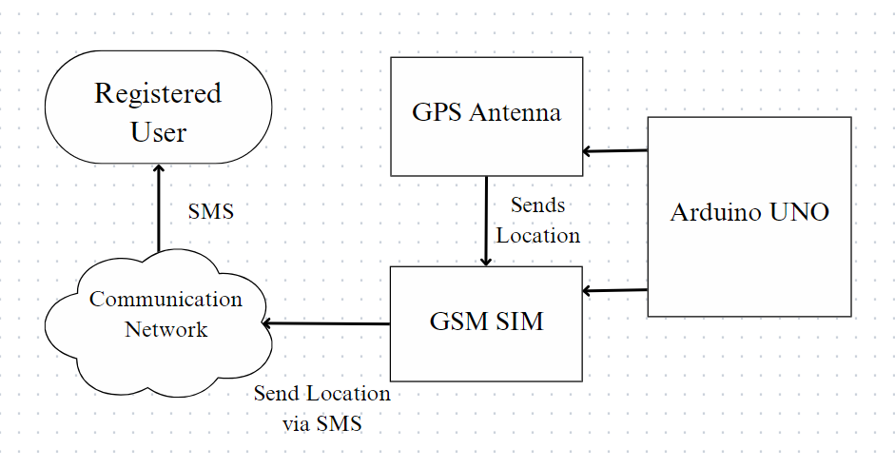
SYSTEM ARCHITECTURE

Slide 14
CONCLUSION
This project successfully demonstrates the integration of a GSM module, GPS module, and Arduino Uno to track and send the location of a specific place. By leveraging the capabilities of these components, we have developed a system that can accurately determine the geographic coordinates of the device and transmit this information via GSM networks. This setup showcases the potential of IoT in enhancing location-based services, offering a practical solution for real-time location tracking with applications in various fields such as asset tracking, personal safety, and fleet management.

Slide 15
FUTURE ENHANCEMENTS
Future enhancements for this project could focus on improving energy efficiency and data accuracy. Implementing advanced power management techniques and utilizing low-power GPS modules can extend battery life, making the system more practical for long-term use. Additionally, integrating machine learning algorithms to predict and compensate for signal loss in urban or remote areas could enhance the reliability and accuracy of location data. Furthermore, expanding the connectivity options to include LoRa or NB-IoT could provide better coverage and lower latency in transmitting location data, ensuring more robust performance in diverse environments.

Slide 16
REFERENCES
[1] Bhawna Gupta, Abhay Gupta, Deepanshu Gupta, SakshamJandial, Raghav Gupta, Dhananjay “Underground Cable Fault Detection using GPS Technology”.
[2] Saideep Sunkari "Smart Vehicle Tracking System using GPS and GSM Technologies”
[3] Ayush Shukla, Himanshu Sable, Sagar Dayal Bhagat, Ravindra “Underground Cable Fault Detection System Using ARDUINO, GSM & GPS”.
[4] A. Ashish Choudhary " IoT Based GPS Location Tracker Using NodeMCU and GPS Module”.
[5] SAniket Parashar, Farah Deeba, "GPS Tracking System Using LoRaWAN" published in the year 2018.

